Slide 1


Final Project Assignment
SERVICE IDE
FOR IOT
APPLICATIONS
By M2M Group

Slide 2

GOALS
CLEAN AND SIMPLE UI
FAST FINALIZATION AND TESTING
A minimal, intuitive interface that reduces distractions and simplifies project creation.
Quickly validate, simulate, and deploy apps with built-in tools and instant feedback.
GRAPHICAL APPROACH
Design IoT apps visually
NO complex coding needed.

Slide 3




LANGUAGES AND LIBRAIES
Tkinter

Slide 4

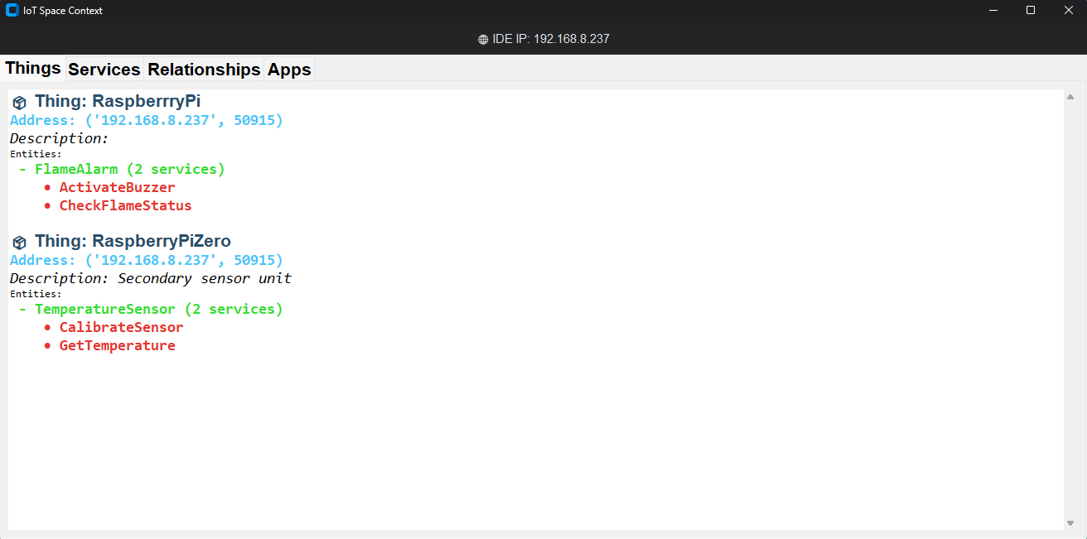
THING TAB

Slide 5

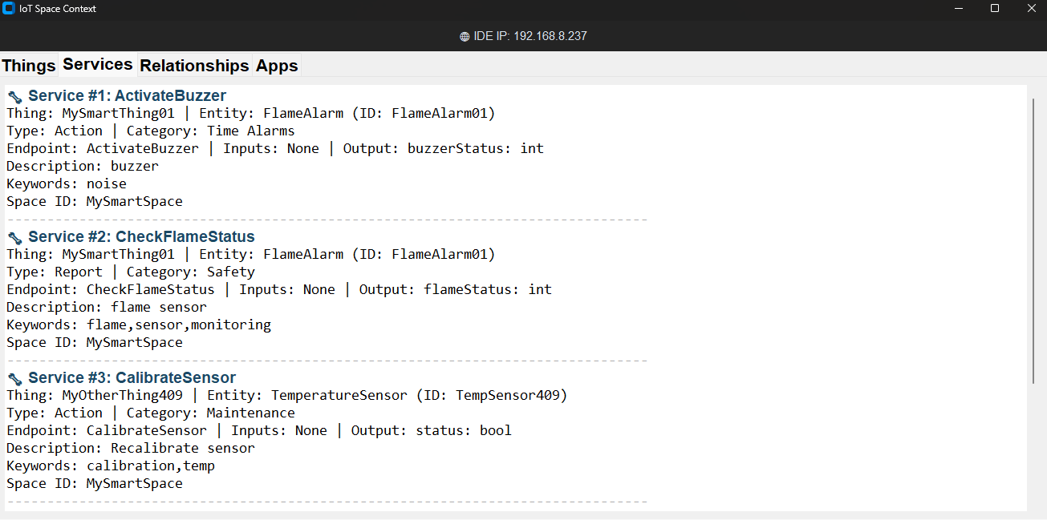
SERVICE TAB

Slide 6
RELATIONSHIP TAB

Slide 7
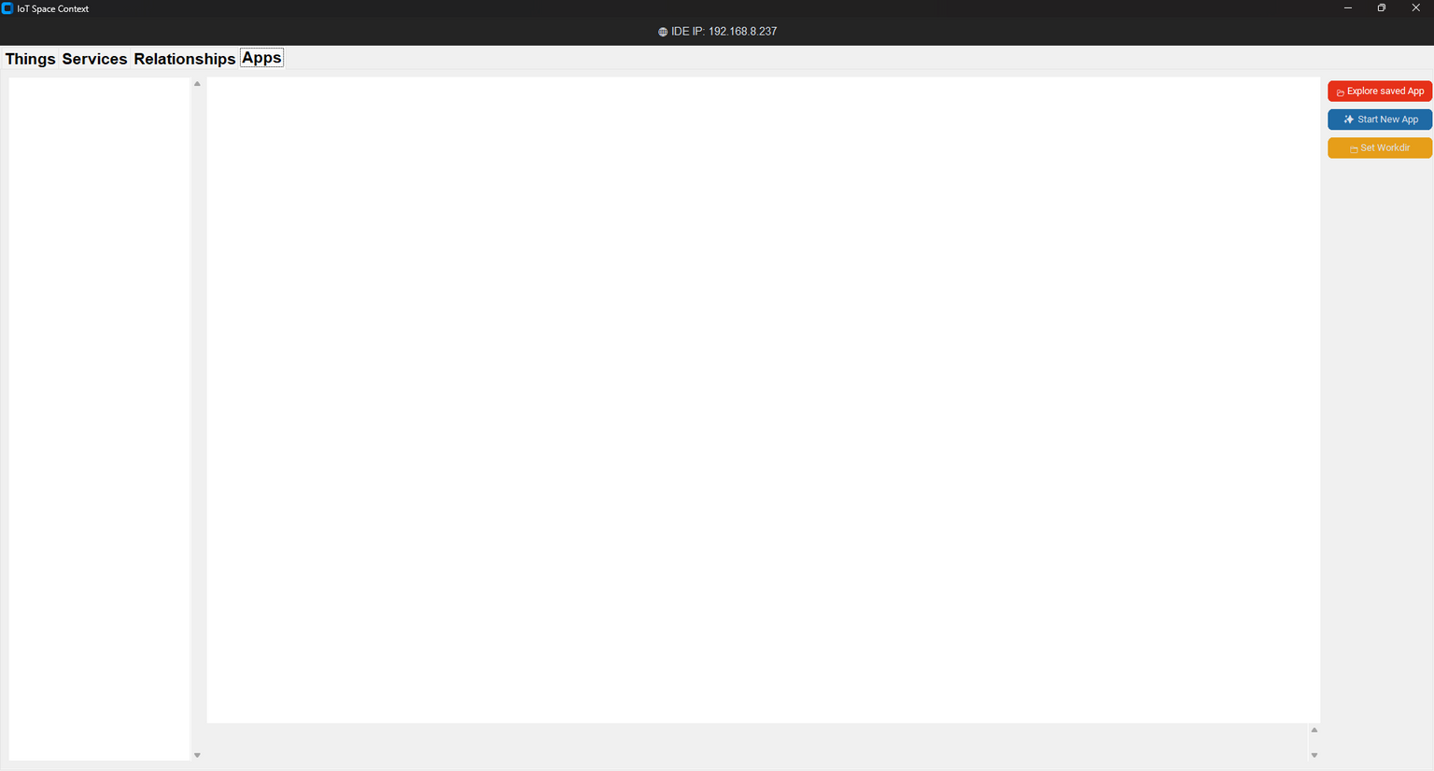
APP TAB

Slide 8
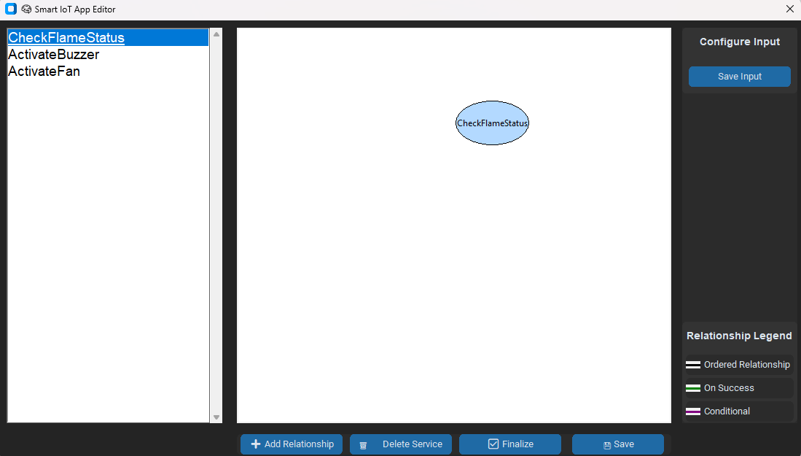
CANVAS SECTION

Slide 9
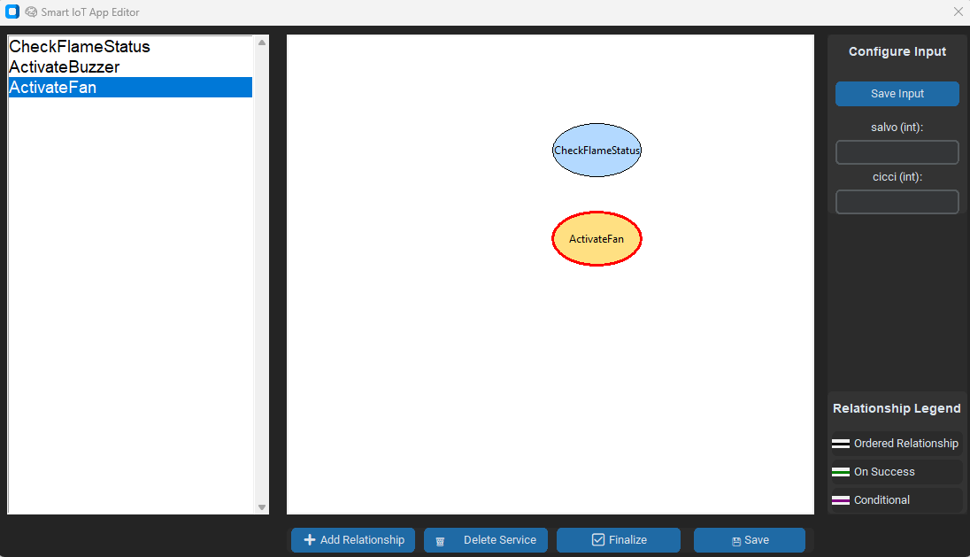
CANVAS SECTION

Slide 10
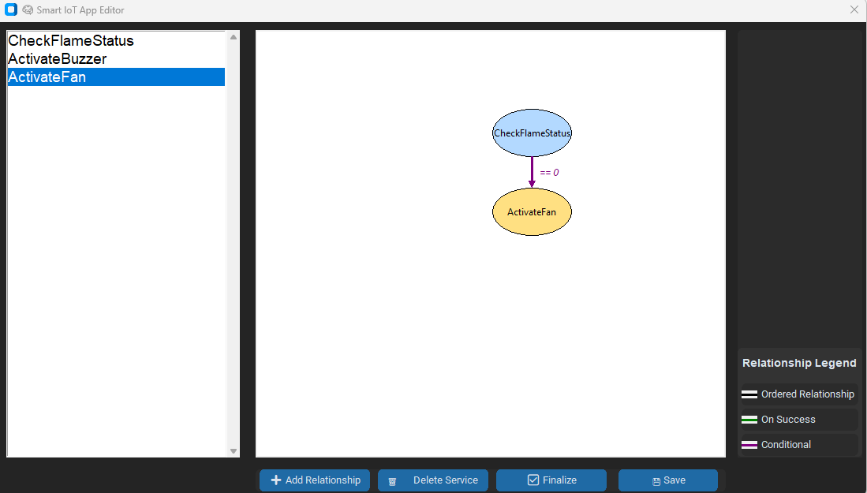
CANVAS SECTION

Slide 11
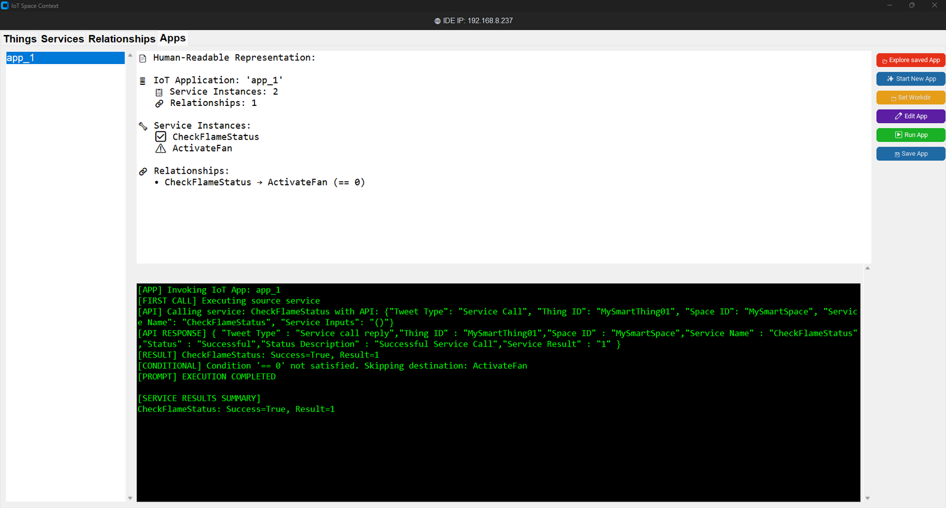
APP TAB

Slide 12
THANKS FOR YOUR ATTENTION !

